Slide 1


Blog Net a web-application
Suneet Kumar Gupta Ruchira Gahlaut E18CSE153

Slide 2

CONTENT
Introduction
Motivation
Approach
User Interface
Glimpse
Result
Future Scope

Slide 3

Blogging is an important part of everyone’s life. People use to share their thoughts through images or texts.
It can be anything like about any topic related to data science or related to travelling or food.
BlogNet aims to give a common platform for all kind of data that people want to share with the world.
INTRODUCTION

Slide 4

MOTIVATION
In today’s time everyone do write their thoughts and want to share with the world.
Many existing sites are also available like medium.com, Instagram but mostly they are meant to a particular topic.
BlogNet giving a common platform to all kind of interest.

Slide 5

APPROACH
Language – JavaScript, Html, CSS.
It is full-stack MERN web application which includes four technologies MongoDB, Express, React, Redux and Node js.
Full stack contains front-end, Back-end and the database
The data we are getting from users is stored in MongoDB atlas.

Slide 6

USER INTERFACE
User interface plays an important role for any project.
My project theme is based on Instagram so that people can easily adapt it.
You have #tags for searching.
Easy to understand.

Slide 7
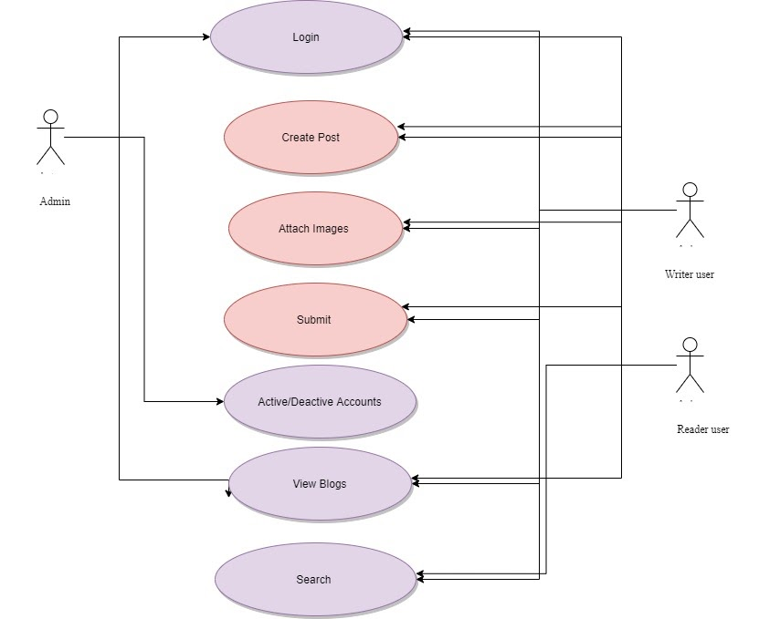

Slide 8
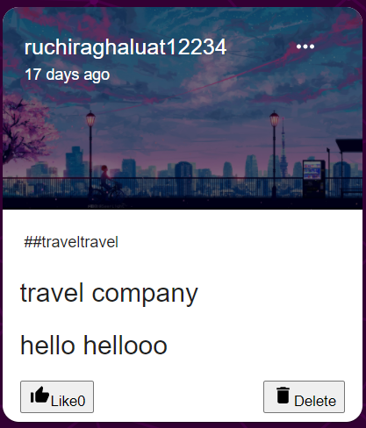
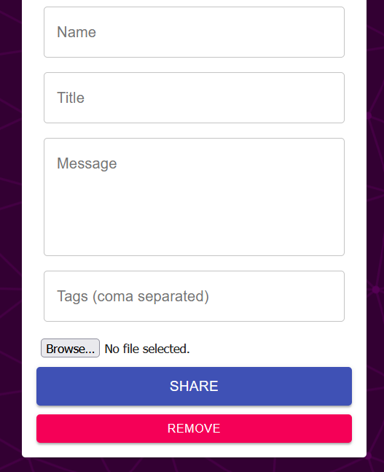
GLIMPSE
Add a post by giving a title
Write your content
You can attach your images as well
After posting it will look like this

Slide 9

RESULT
A web application where people can post their thoughts in the form of post.
Post has different features like –
You can attach your images with it.
You can add the #tags
You can write it about your topic
You can submit or clear it

Slide 10
After posting your post also you have the option to edit it.
A common platform where you put your thoughts in a easy way.
As a reader –
You can like the post.
You can dislike the post.

Slide 11

FUTURE SCOPE
It is very applicable for patent. Why ?
This is platform where people can easily do their advertisement for their product.
Handmade products or small business advertisements can do here.

Slide 12
THANK YOU

